Slide 1
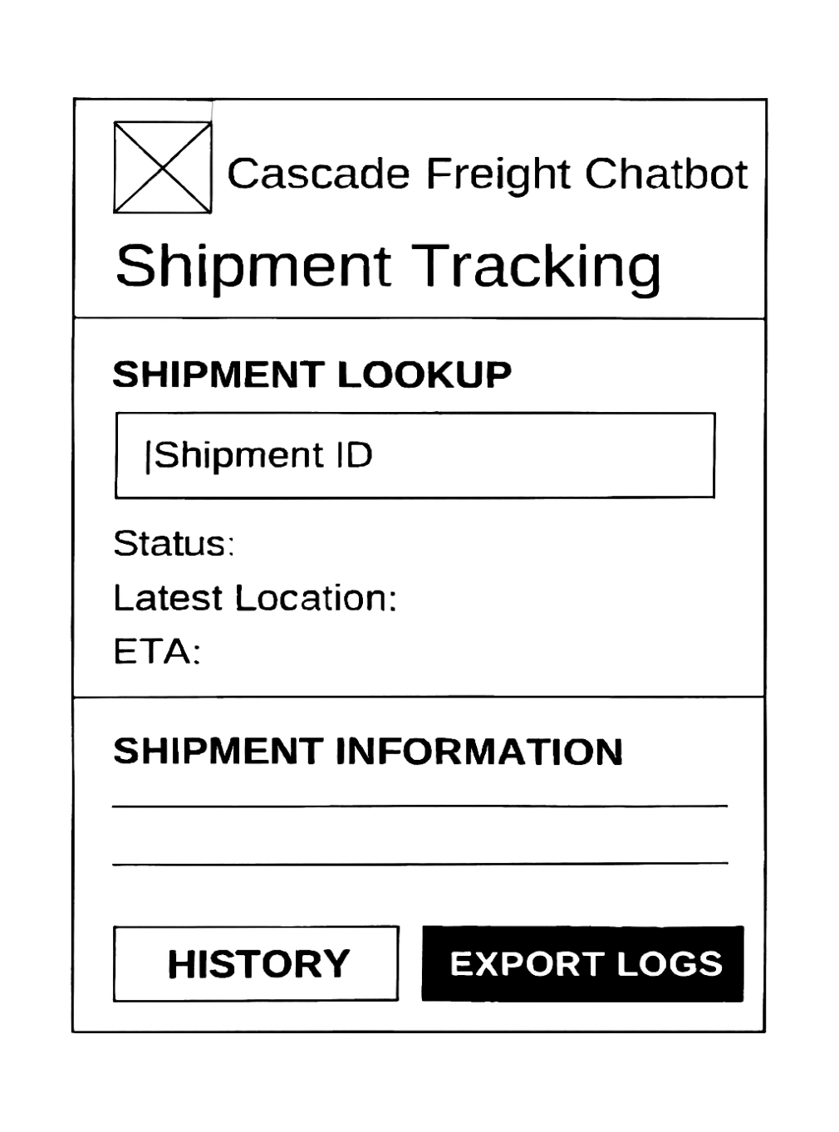
Cascade Freight Systems Chatbot
User Account Administration
User Story – 3.0 Shipment Tracking
As a dispatcher, I want to enter a shipment ID and receive its status, latest location, and ETA so that I can track shipments in real time and respond to inquiries efficiently..
Development Tasks
Build chatbot input handling for shipment ID lookup.
Connect to shipment tracking database to retrieve status, location, and ETA.
Format response to populate all three fields clearly in the chatbot interface.
Implement “HISTORY” button to show past shipment events.
Enable “EXPORT LOGS” to download shipment history for audit or reporting.

Slide 2
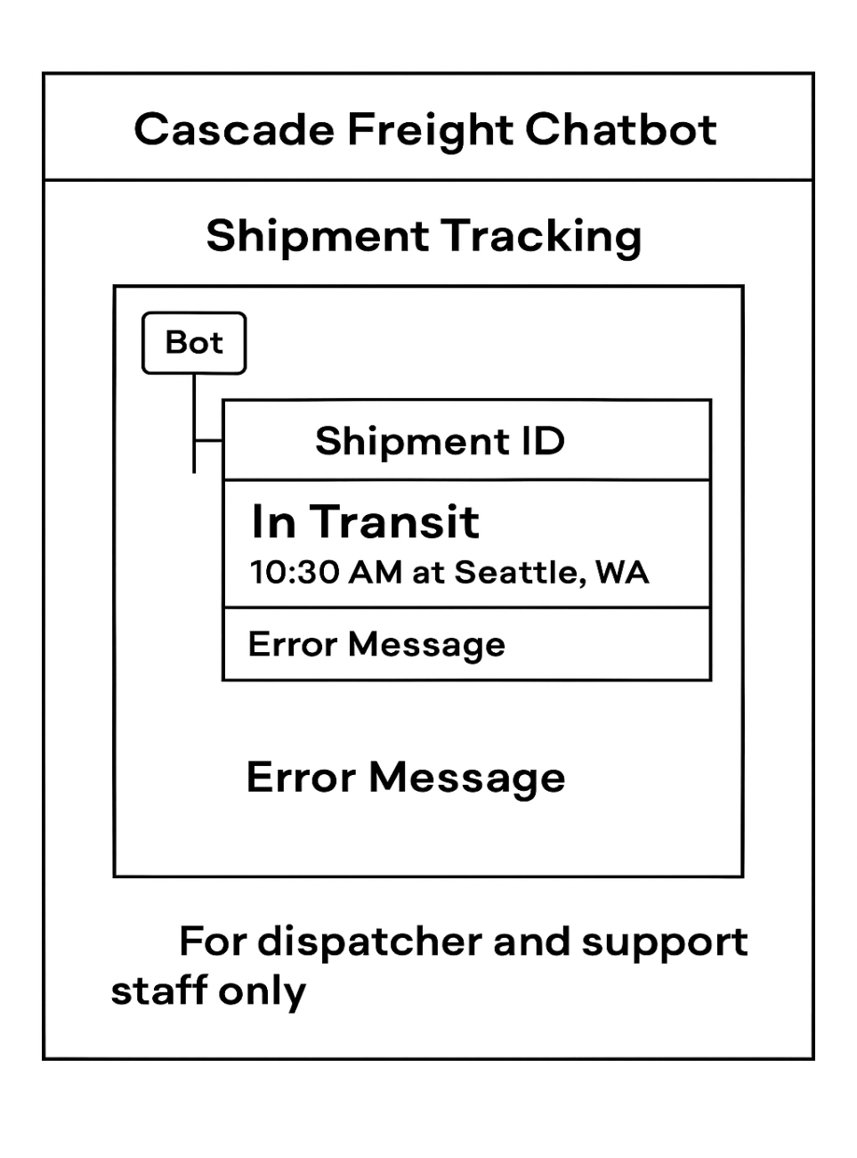
Cascade Freight Systems Chatbot
User Account Administration
User Story – 3.1 Status Query
As a dispatcher or support staff, I want the chatbot to return the current shipment status (pending, in transit with timestamp/location, or delivered with confirmation) after entering its ID so that I can monitor progress and respond to inquiries efficiently.
Development Tasks
Query shipment database for status, timestamp, and location based on entered ID.
Format chatbot response to handle all status types (pending, in transit, delivered) consistently.
Implement role‑based access to restrict this view to dispatchers and support staff.
Add error handling for invalid shipment IDs or missing data.
Test status queries with sample shipments to validate accuracy and response time.

Slide 3
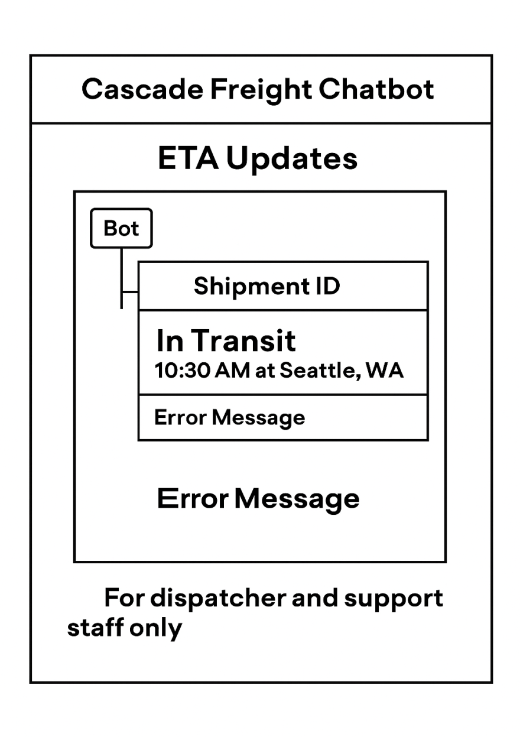
Cascade Freight Systems Chatbot
User Account Administration
User Story – 3.2 ETA Updates
As a dispatcher or support staff, I want the chatbot to provide estimated arrival times for shipments so that I can plan resources and keep customers informed.
Development Tasks
Integrate chatbot with routing and shipment database to calculate ETA based on current location and conditions.
Format chatbot response to display ETA clearly alongside status and location.
Implement dynamic updates so ETA adjusts automatically if delays or reroutes occur.
Add error handling for missing or inconsistent route data.
Test ETA calculations with sample shipments to validate accuracy and responsiveness.

Slide 4
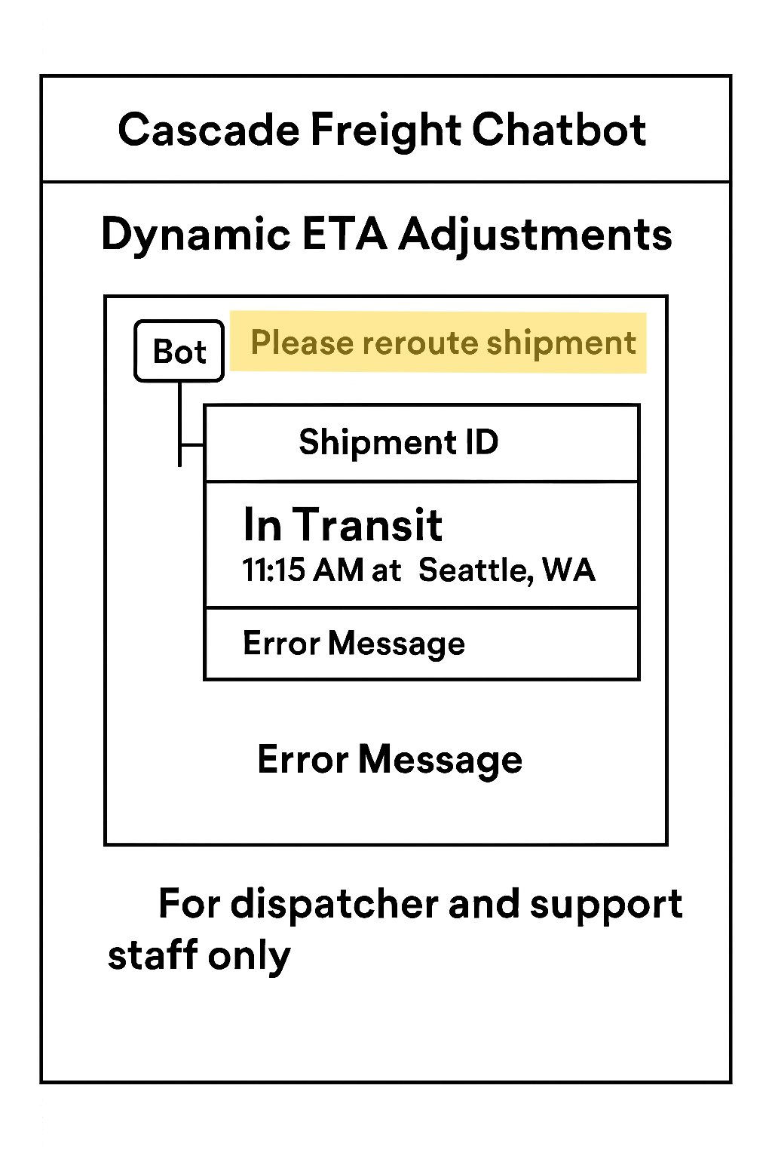
Cascade Freight Systems Chatbot
User Account Administration
User Story – 3.2.1 Dynamic ETA Adjustments
As a dispatcher or support staff, I want the chatbot to automatically adjust shipment ETAs when delays or reroutes occur so that I can provide accurate arrival times and manage expectations.
Development Tasks
Implement logic to recalculate ETA whenever shipment status or route data changes.
Integrate with routing system to detect delays, reroutes, or traffic conditions in real time.
Format chatbot responses to show updated ETA clearly alongside shipment status.
Add alert mechanism to notify dispatchers when ETA changes significantly.
Test dynamic ETA updates with simulated delays and reroutes to validate accuracy.

Slide 5
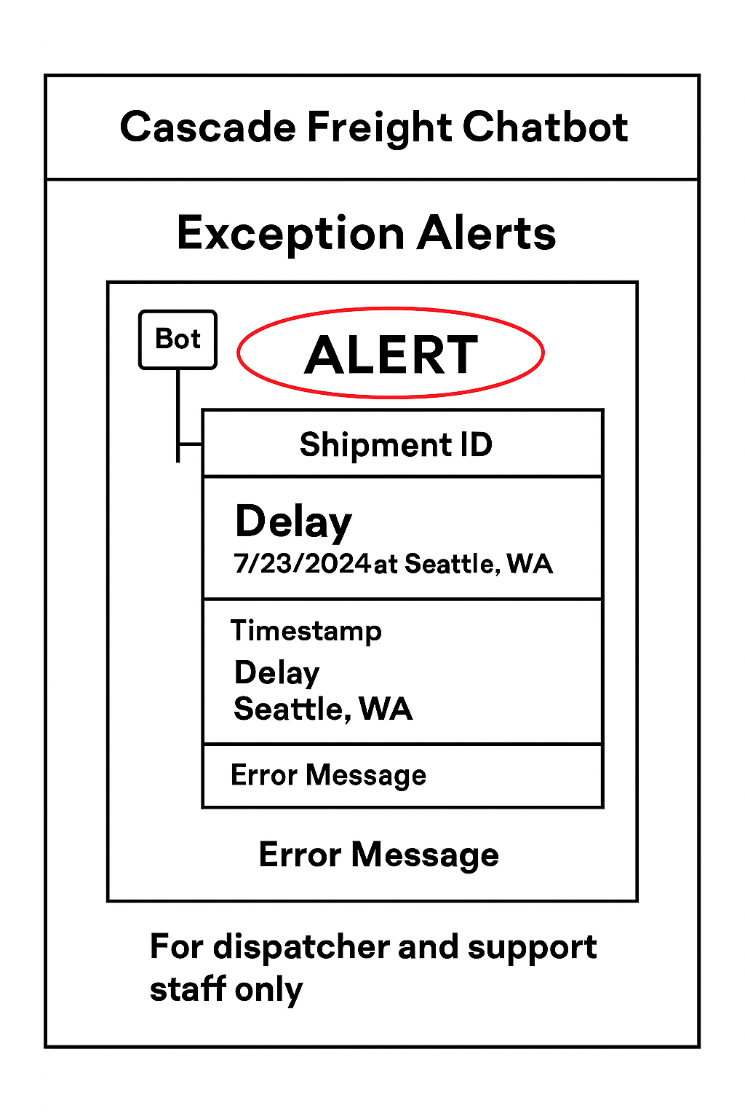
Cascade Freight Systems Chatbot
User Account Administration
User Story – 3.2.2 Exception Alerts
As a dispatcher or support staff, I want the chatbot to automatically alert me when shipment exceptions occur (such as delays, reroutes, or damaged goods) so that I can respond quickly and keep operations running smoothly.
Development Tasks
Integrate chatbot with shipment tracking system to detect exceptions in real time.
Format alerts clearly with shipment ID, type of issue, timestamp, and location.
Implement role‑based access so only authorized staff receive exception alerts.
Add notification logic to prioritize urgent issues (e.g., delays vs. damaged goods).
Test exception scenarios with simulated shipments to validate alert accuracy and timeliness.

Slide 6
Cascade Freight Systems Chatbot
User Account Administration
User Story – 3.2.3 Route Change Alerts
As a dispatcher or support staff, I want the chatbot to notify me when a shipment has been rerouted so that I can update delivery expectations and coordinate resources accordingly.
Development Tasks
Integrate chatbot with routing system to detect route changes in real time.
Format alerts to include shipment ID, new route details, timestamp, and reason for reroute (if available).
Implement role‑based access so only authorized staff receive route change alerts.
Add notification logic to highlight reroutes as high‑priority events
Test route change scenarios with sample shipments to validate alert accuracy and timeliness.

Slide 7
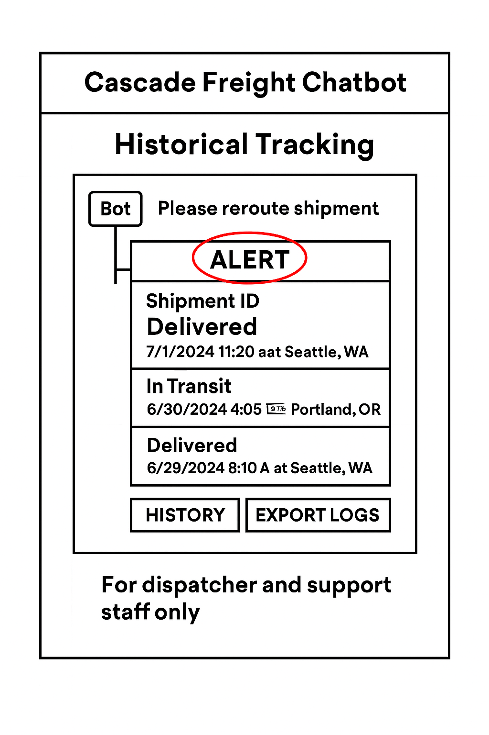
Cascade Freight Systems Chatbot
User Account Administration
User Story – 3.3 Historical Tracking
As a dispatcher or support staff, I want the chatbot to provide access to historical shipment records so that I can review past deliveries, audit performance, and generate reports when needed.
Development Tasks
Connect chatbot to shipment database with query capability for past records.
Format responses to display shipment history clearly (status changes, timestamps, locations).
Implement filtering options (by shipment ID, date range, or driver) for efficient lookups.
Add “Export Logs” functionality to securely download shipment history for audits.
Test historical tracking with sample records to validate accuracy and usability.

